Slide 1
Mordiou!
Good Fortune
{☐☐☐}
Effort {☐☐☐☐☐}
Help Pool
Receive help from an ally
Counter Pool
Reserve to cancel actions
Once full lose 1 Fortune
Spend 1 for 1 extra action
Defense Pool
2 until you assign tokens
______________☐
______________☐
Spend to add a token
Condition reduces it by 1
If empty, you can spend ½ of your defense to parry
Aspects & conflict stances : Check one for +2, once all checked, reset at the end of scene
& ☐
& ☐
Name & title :
& ☐
& ☐
Attention
{ }
Move x1
Eloquence { }
Erudition { }
Panache { }
Resolution { }
Ruse { }
Vigor { }
Counter x2
Act x∞
Help x3
Restore x1
Act x∞
Attack x2
Counter x1
Act x∞
Attack x1
Act x∞
Attack x1
Act x∞
Attack x3
Move x2
Help x1
Act x∞
Help x3
Counter x2
Move x3
Restore x3
Move x2
Move x3
Help x2
Counter x3
Help x2
Attack x1
Act x∞

Slide 2
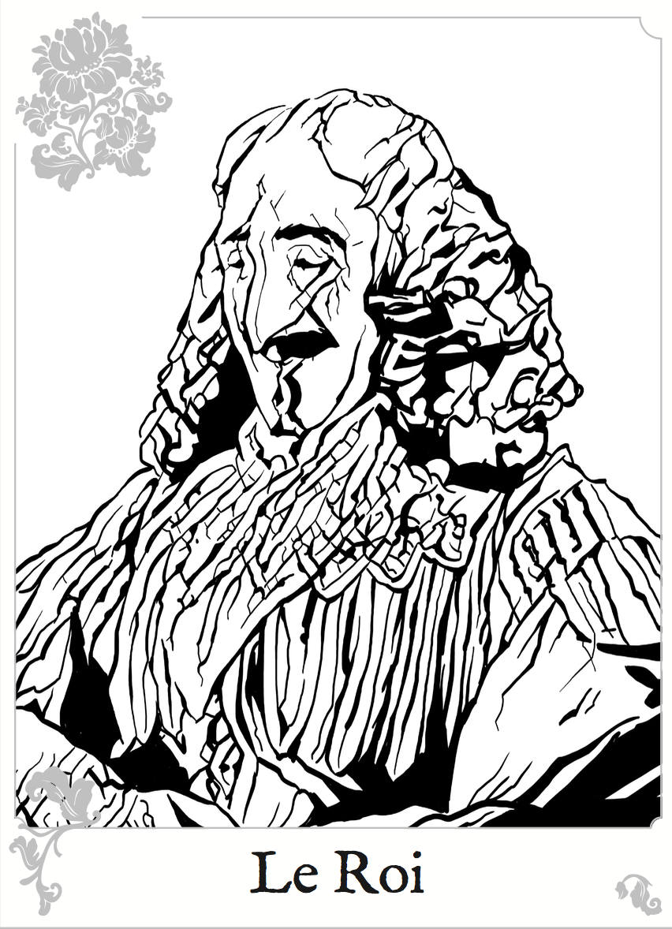
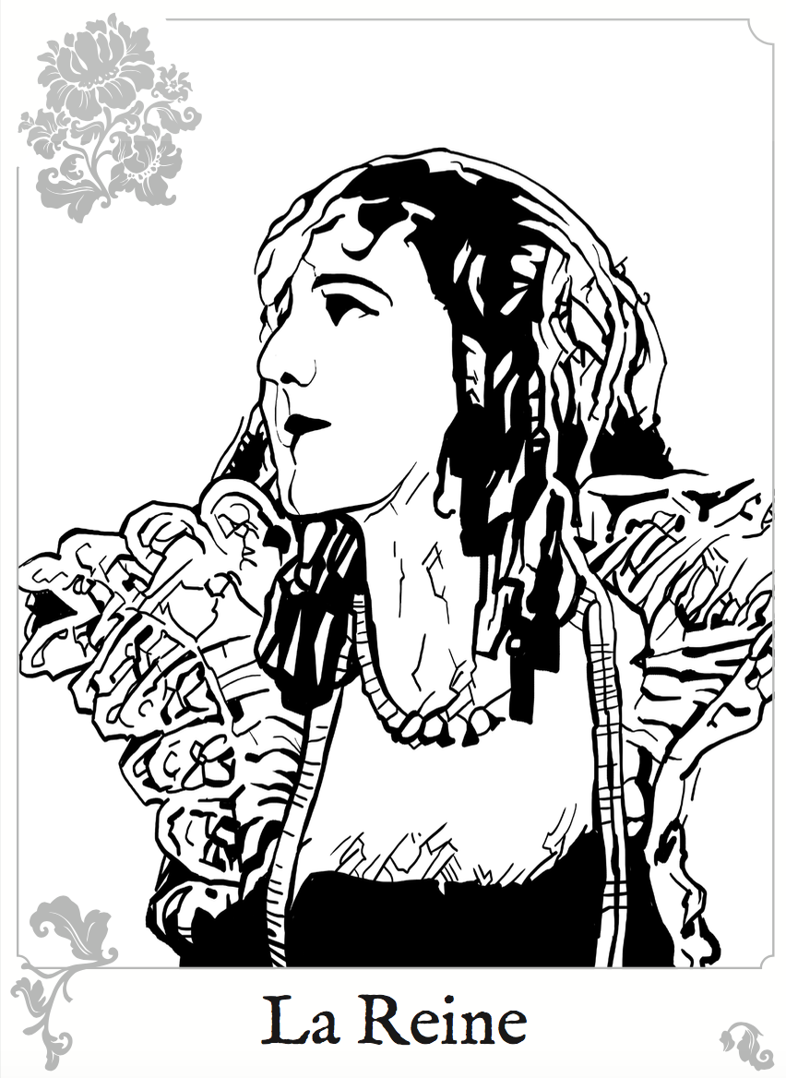
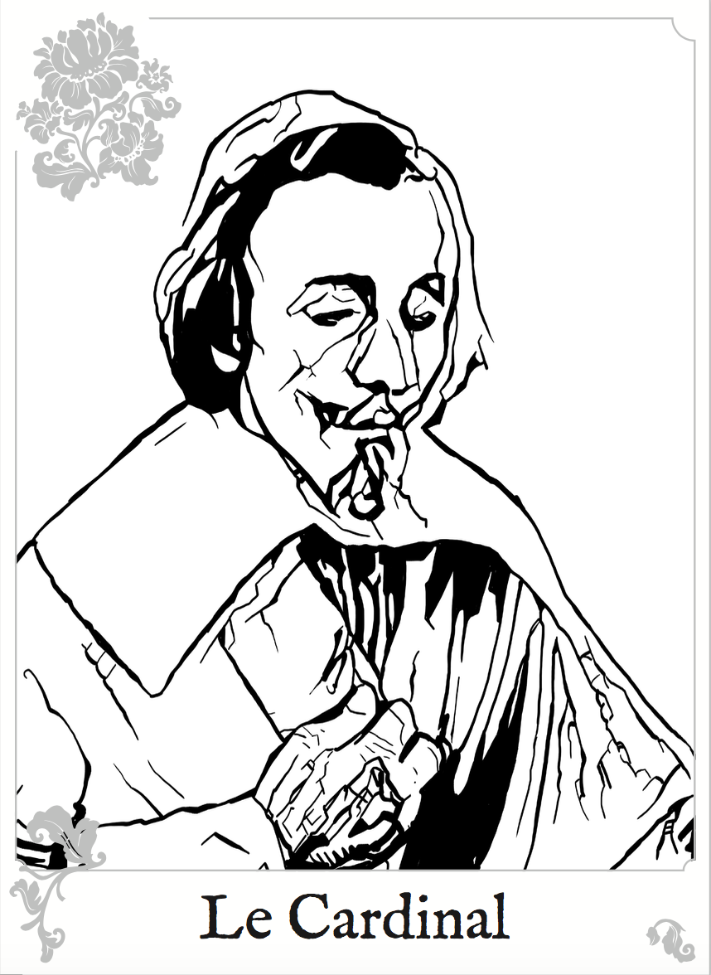
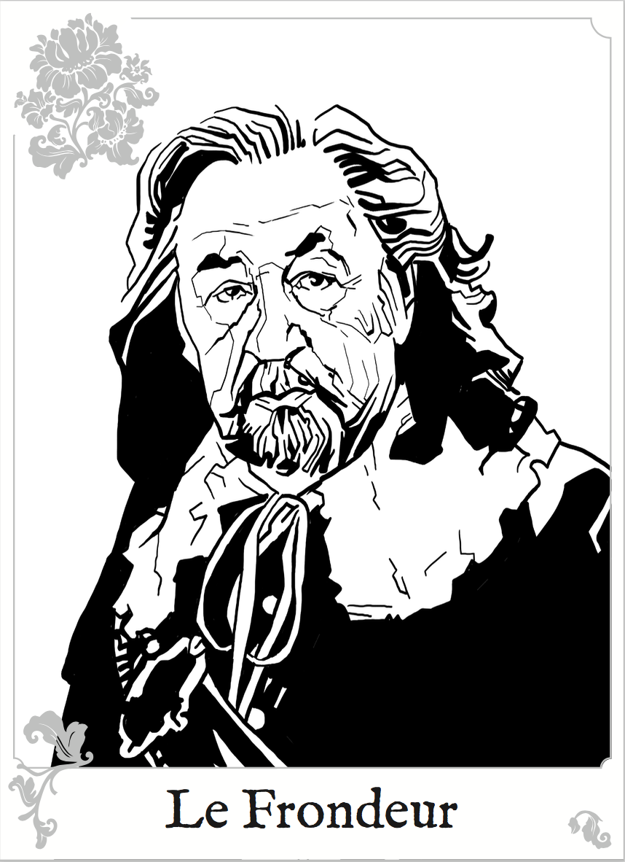
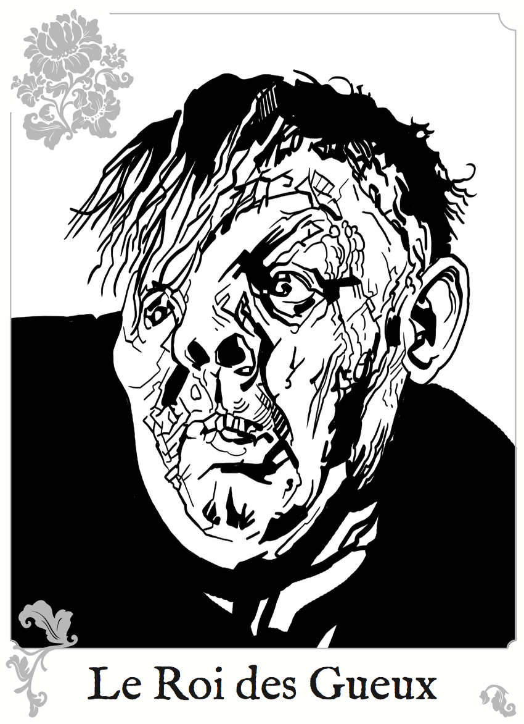
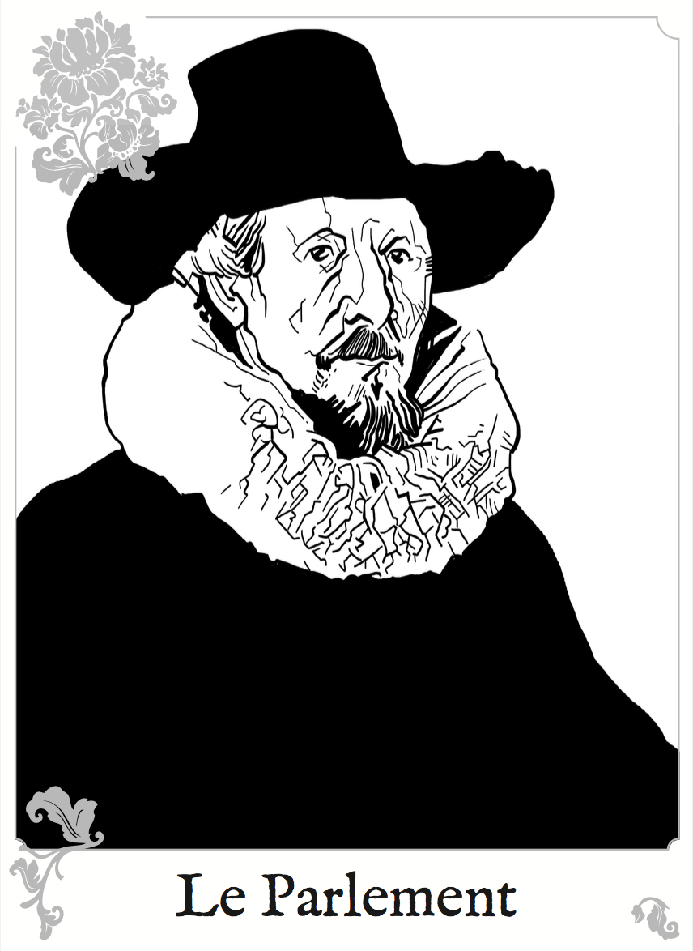
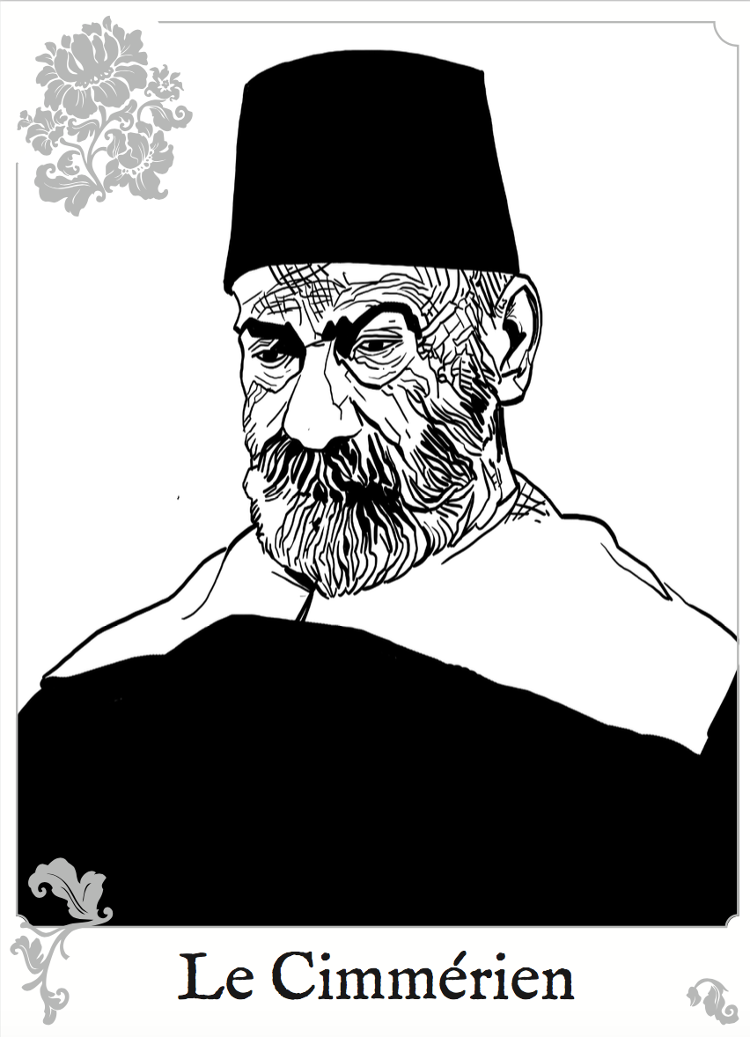
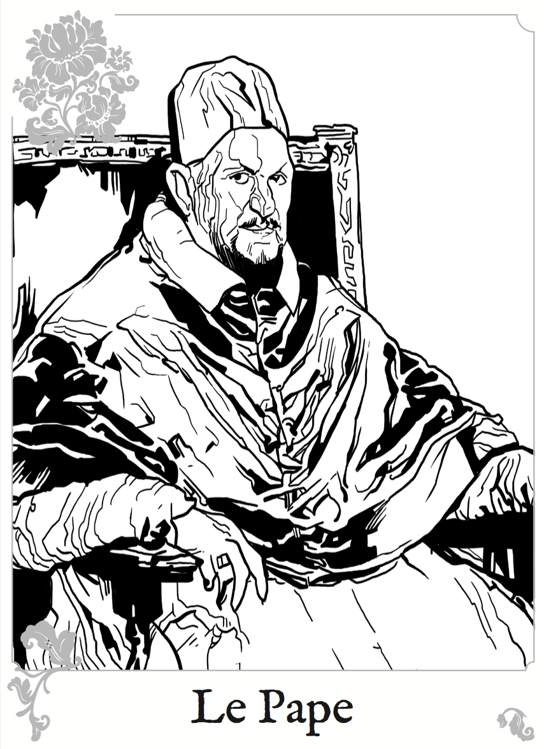
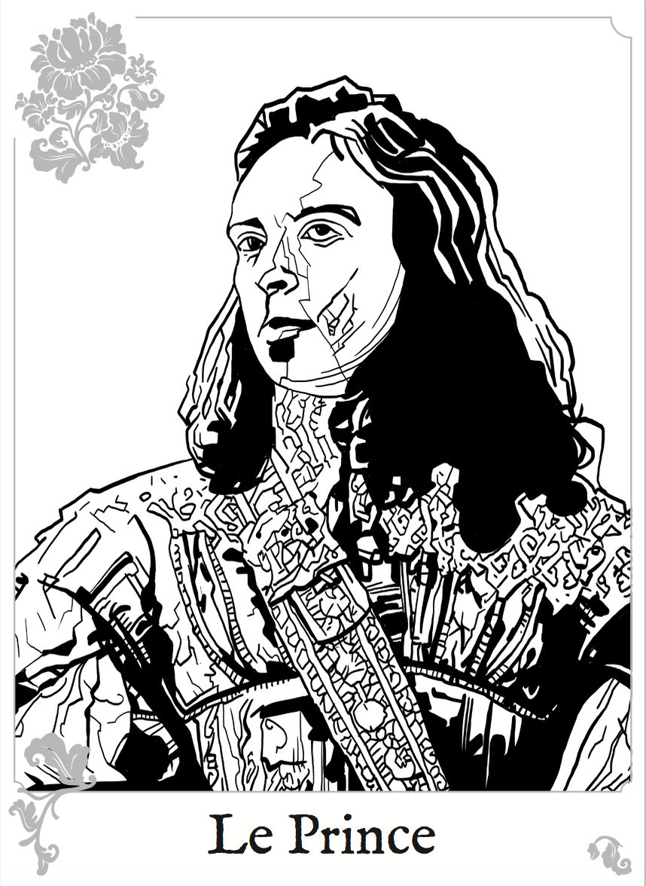
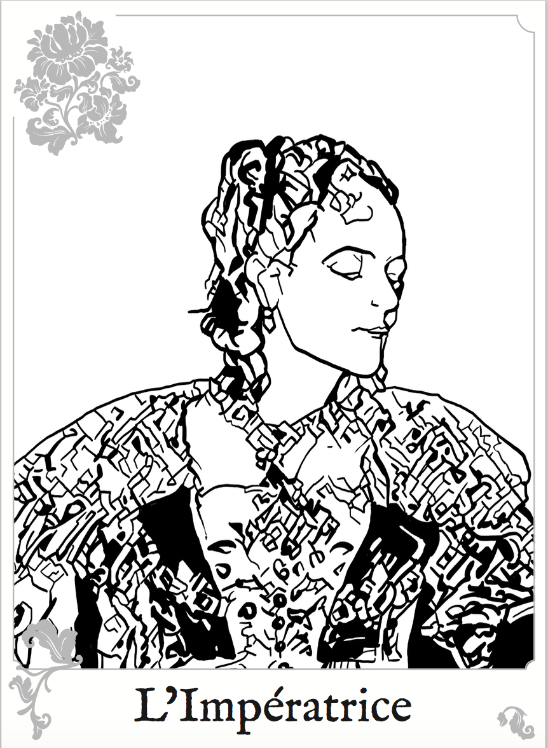
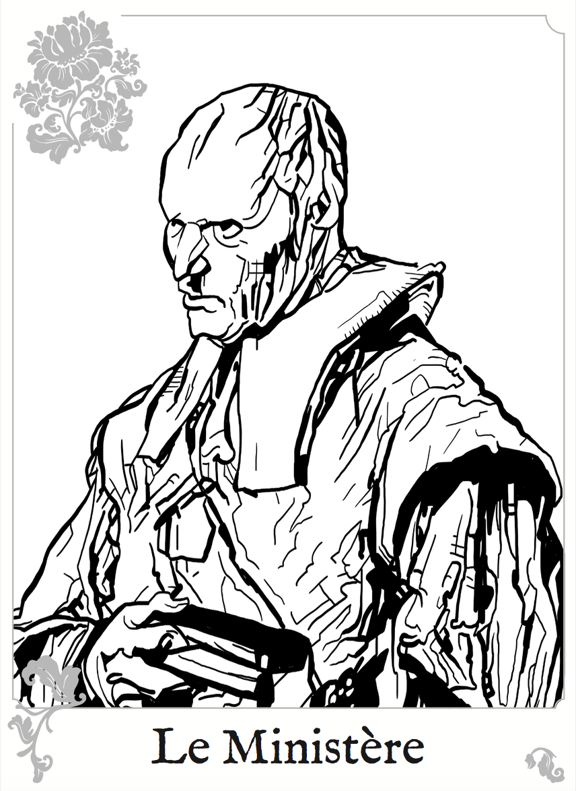
Mordiou!
Rules in conflict Initiative : Once per scene, round table order. The first player will be among the highest fortune. Pick a Style: Collect tokens = Fortune + Style Add +2 tokens if an Aspect is used (check the aspect) Add afterward 1 help token if you need Max number of tokens is always 8 Count tokens: Sum the number of Success (S) and sum the number of Actions (A) Defense: Assign unused tokens to your defense (usually the white) Bargain: You can pick a bargain for 2 success to avoid some consequences or target more than 1 opponent (then use the highest of their defense) | Compare number of Success to the target Defense Zero } Catastrophic Failure S < D } Failure, no action (only 1 move or act is allowed) S >= D } Hit, take your actions (1 per token) S>=2D } Perfect Hit, take actions and wound the target (it loses 1 fortune) In conflict, once hit, pick actions in the limits of the style selected. You can push your limits and spend 1 Effort to gain one extra action. | Actions in conflict :
Token | Success | Action | %
Red | 2 | 1 | 16.67%
White | 1 | 1 | 33.33%
Blue | 0 | 0 | 50%
Attack | Inflict 1 effort damage or 1 condition to an adversary
Counter | Keep, and use later to cancel 1 action (except fortune loss)
Help | Give a token to an ally, they can spend to add to it’s tokens
Move | Manoeuver or pursuit or highest takes initiative
Restore | Uncheck 1 effort on you, or remove 1 condition on ally
Act | Chat, use props, do secondary actions

